Slide 1
GNSS-Synchronized Distributed Open Radio telescope array And Signal Processing Network
Stephen Wang

Slide 2
GNSS-Synchronized Distributed Open Radio telescope array & Signal Processing Network
Inspired by recent advance in radio telescope projects, digital signal processing and distributed computing technologies
VLBI radio telescope array, Einstein@Home, SETI@home,
Low-cost software defined radio receiver receiver with gigahertz RF and heterogenous computing,
Open distributed computing infrastructure, such as BONIC
Develop an ultra-low cost GPS-synchronized distributed radio telescope array from off-shelf components
Phase I: the target price is $200 per telescope, which receives radio signals between 500kHz~1.7GHz
Phase II: the telescope will receive radio signals up to 6GHz using commercial 5G RF components.
Process received digital signals in a distributed signal processing network (DSPN)

Slide 3
System components
GNSS-Synchronized Radio Telescope Station
Antennas:
radio telescope antenna: UHF antenna (Phase I)
GNSS antenna:
Communication (included in the SPCC Module below )
RF Front-Ends:
GNSS RF Front-End:
Telescope RF Front-End:
Communication RF Front-End: (included in the SPCC Module below)
Signal Processing, Control and Communication (SPCC) Module: Raspberry Pi computer
Data Storage: 128 GB microSD flash card
Power Supply: high-capacity portable cell-phone external battery bank; solar-panel
Distributed Signal Processing Network (DSPN)

Slide 4
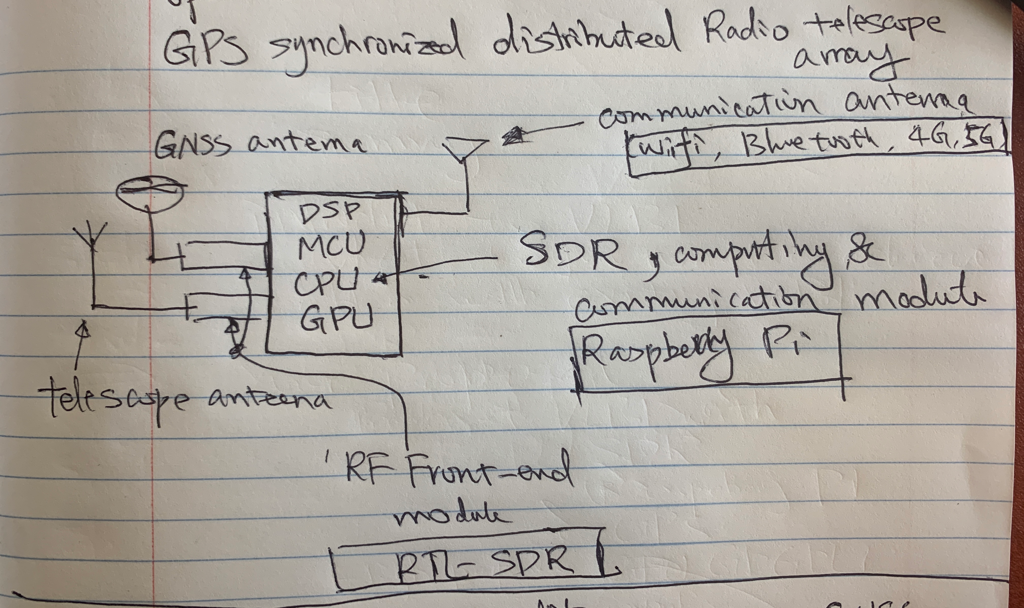
GNSS-Synchronized Radio Telescope Station

Slide 5
Distributed Signal Processing Network

Slide 6
Phased Development
 | Phase I | Phase II | Phase III | Phase IV (TBD)
Radio Frequency up to 1.7GHz | ✓ | ✓ | ✓
GPS-Base Synchronization | ✓ | ✓ | ✓
Distributed Signal Processing in BOINC | ✓ | ✓ | ✓
Battery Power Supply | ✓ | ✓ | ✓
Radio Frequency up to 6GHz |  | ✓ | ✓
Distributed File Synchronization |  | ✓ | ✓
Wi-Fi Mesh Network |  | ✓ | ✓
Solar Panel Power Supply |  |  | ✓
Data Integrity Guard |  |  | ✓
GPGPU Processing Acceleration |  |  | ✓
Airborne Deployment Capable |  |  | ✓

Slide 7
Phase I Radio Telescope Station Component List (1/2)
 | UHF Antenna $12~$90 | GNSS Antenna $8~$160 | RTL-SDR $22~$30 | Raspberry Pi 4 $60~$100 | MicroSD Card $20 | Lithium Polymer Battery $27
Telescope Antenna | ✓
GNSS Antenna |  | ✓
Communication Antenna |  |  |  | ✓
Radio Telescope RF Front End |  |  | ✓
GNSS RF Front-End |  |  | ✓
Signal Processing, Control and Communication Module |  |  |  | ✓
Data Storage |  |  |  |  | ✓
Power Supply |  |  |  |  |  | ✓

Slide 8
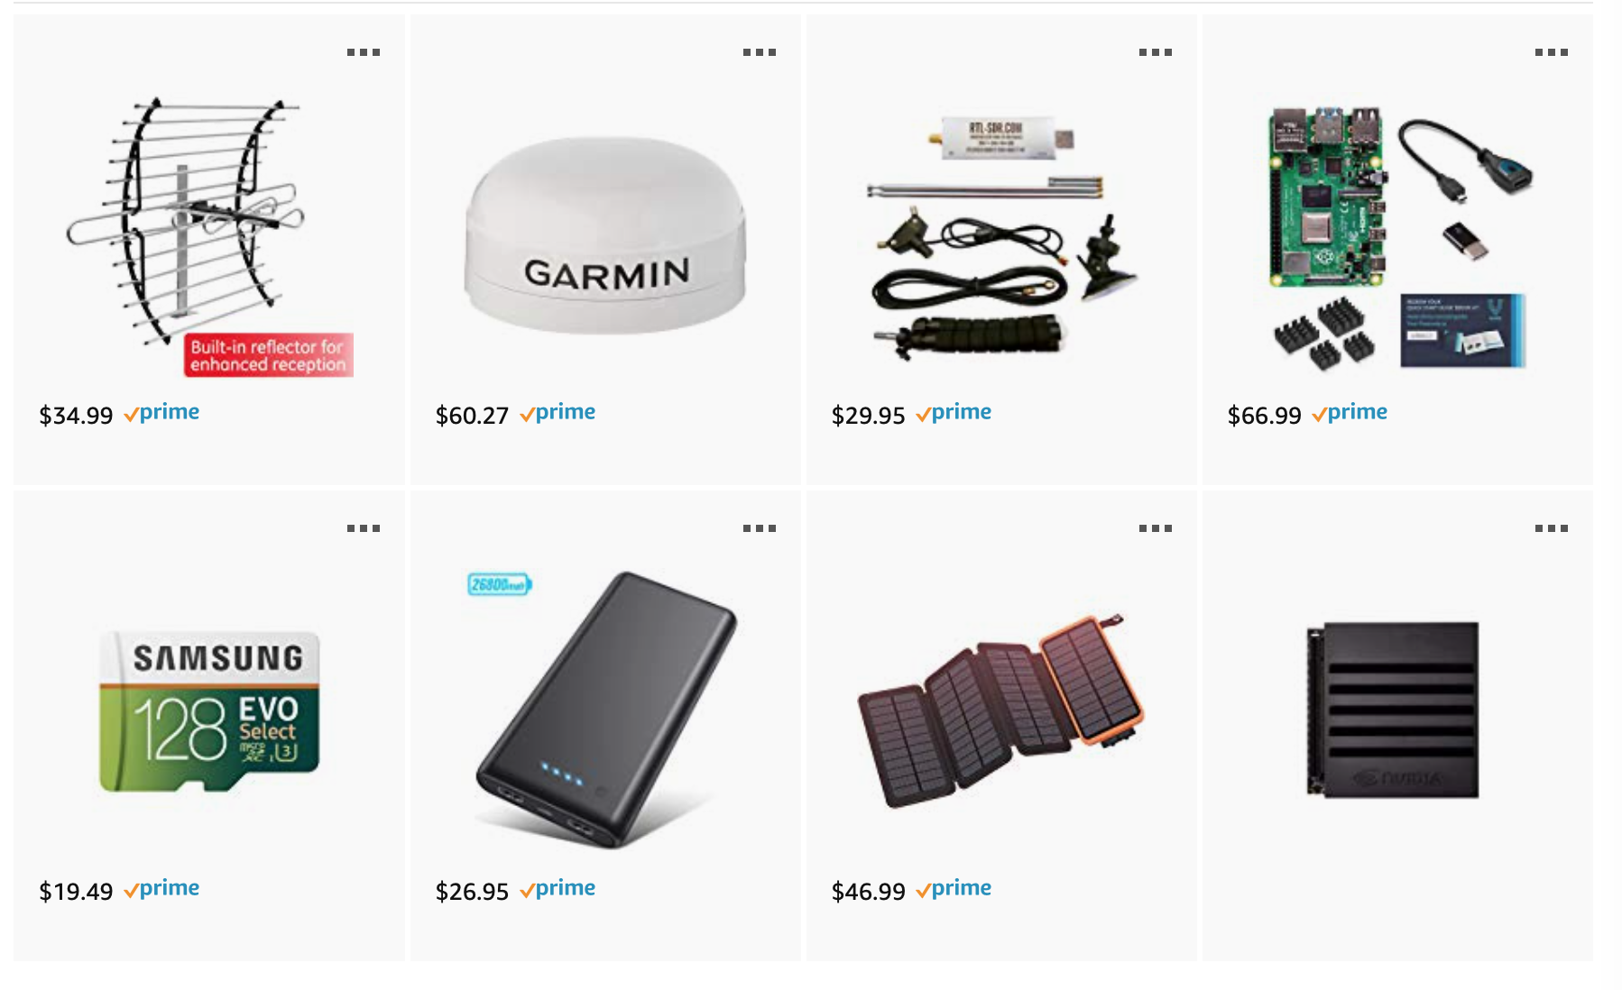
Phase I Radio Telescope Station Component List (2/2)

Slide 9
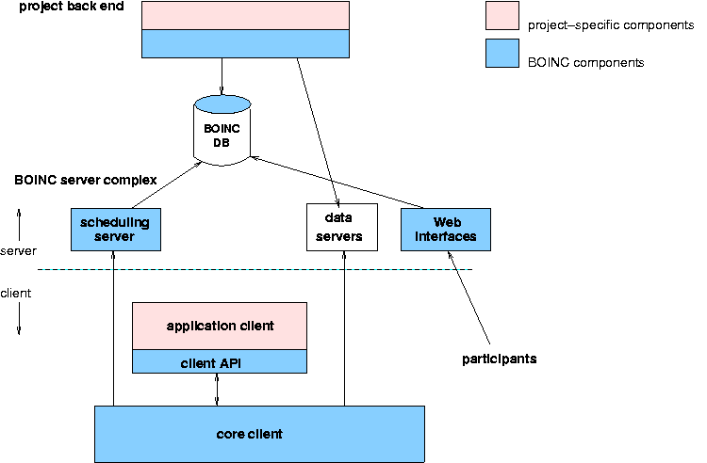
Distributed Signal Processing Network (DSPN)

Slide 10
BOM Comparison

Slide 11
Main Technologies Used In The Proposal
Software Defined Coherent Receivers
Each radio telescope station has at least two antenna and RF Front-Ends.
These two RF Front-Ends are modified to share the same clock
Heterogeneous CPU/GPU Computing
The GPU of Raspberry PI is used for processing received signals.
The CPU of Raspberry PI is used for controlling the operation and communication of each radio telescope station.
GPS-Based Distributed Clock Synchronization
GPS signals are used as a clock reference for radio signal reception.
Distributed Computing
The signals received from the distributed radio telescope array are combined and processed in the distributed signal processing network, as such BOINC.

Slide 12
Software Defined Coherent Receivers

Slide 13
Heterogeneous CPU/GPU Computing

Slide 14
GPS-Based Distributed Clock Synchronization

Slide 15
Distributed Computing

